Slide 1
Algorithmic Interventions to Mitigate Inventory and Ordering Amplification in Multi-echelon Supply Chains
Model-Based vs Model-Free Approaches
INFORMS 2021 Annual Meeting
October 24th – 27th, 2021
James Paine
jpaine@mit.edu
https://jpaine.mit.edu

Slide 2



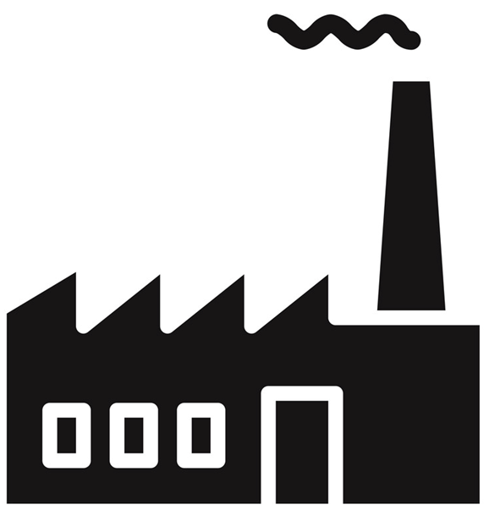
Multi-Echelon Supply Chains
Orders
Shipments

Slide 3
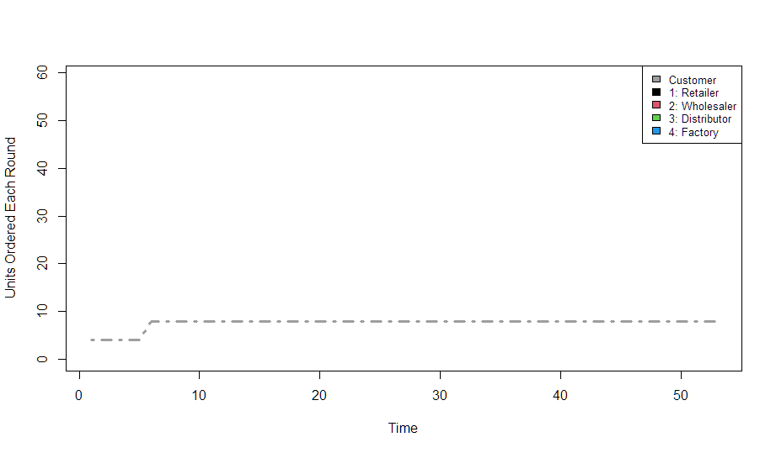
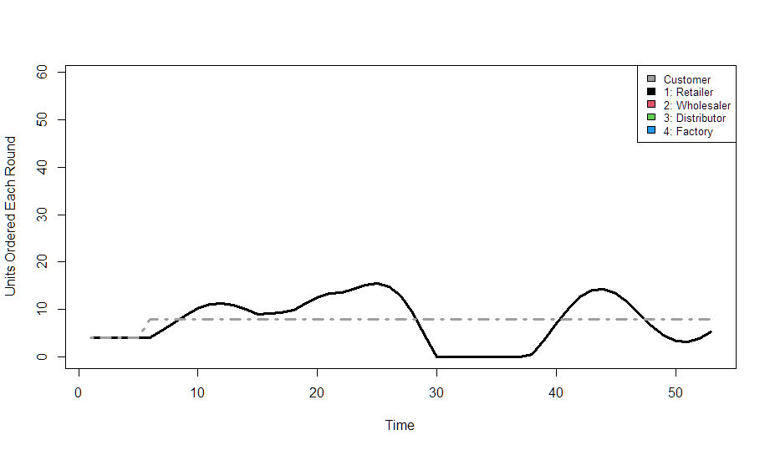
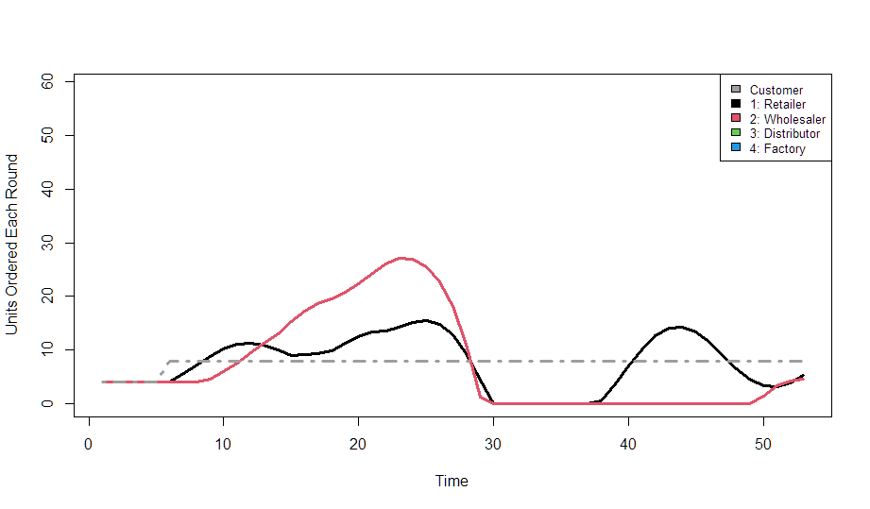
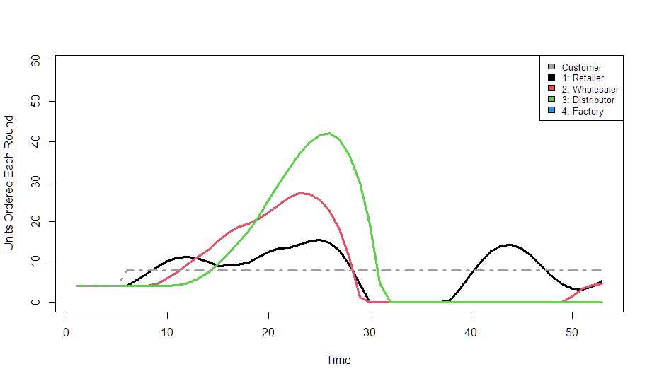
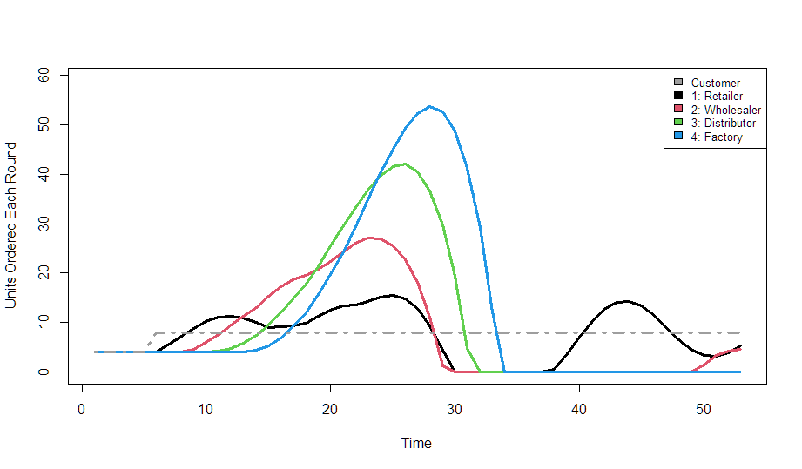
Bullwhip
Bullwhip =
Amplification
& Phase Shift

Slide 4
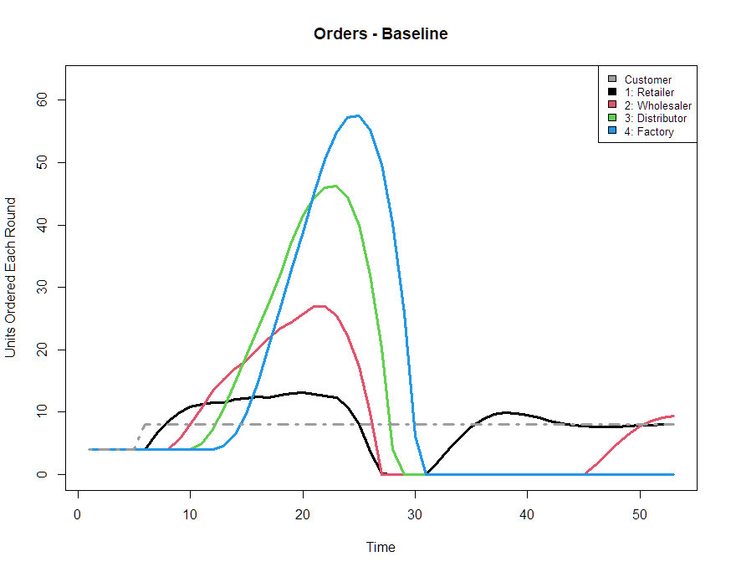
Bullwhip is Persistent (and behavioral)
Bullwhip Effect
Increasing amplitudes in both orders and on-hand inventory positions the further one moves away from a source of order variability
This is a persistently observable phenomena in supply chains
Previous Work has Highlighted Behavioral Sources and possible solutions
Sterman (1989) and Croson/Donohue (2006) emphasize supply chain underweighting
Narayanan/Moritz operationalize supply chain underweighting and emphasize desirability to introduce decision-making behaviors consistent with high cognitive reﬂection
Model-Free reinforcement learning approaches have had recent success
Chaharsooghi et.al. 2008 apply reinforcement learning to model supply chain with full information sharing
Oroojlooyjadid et. al. 2021 modify DQN to more realistic model of multi-echelon supply chain with limited information
Gap Exists to:
Contrast and compare model-based and model-free approaches to bullwhip mitigation
Directly examine the resulting ordering schemes in the context of existing behavioral literature

Slide 5
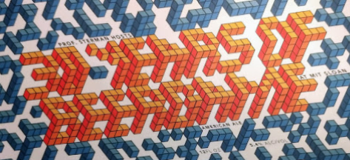
Modeling Framework: THE BEER GAME
The Beer Game is…
is a classical inventory management and System Dynamics simulation and learning tool
Multi-agent decentralized supply chain is modeled, much like real decentralized inventory management systems
Over 50 years of history (and data) at MIT as use as a business simulator and teaching tool

Slide 6
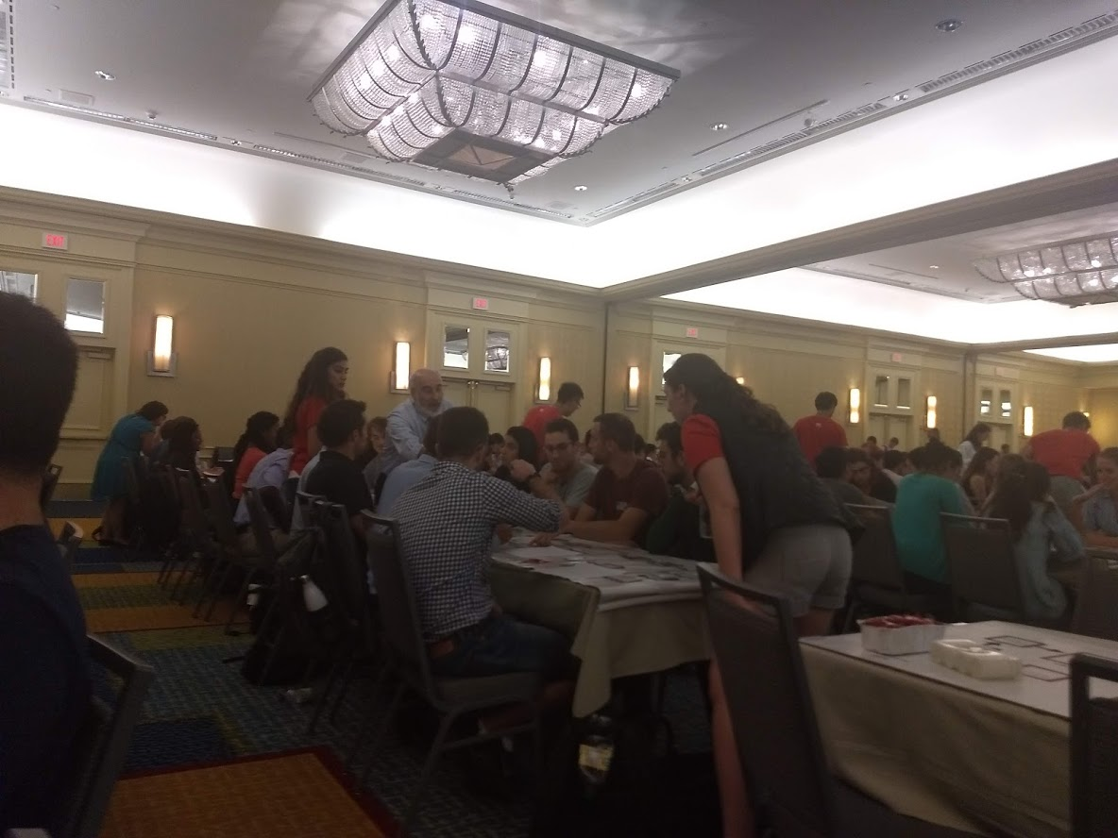
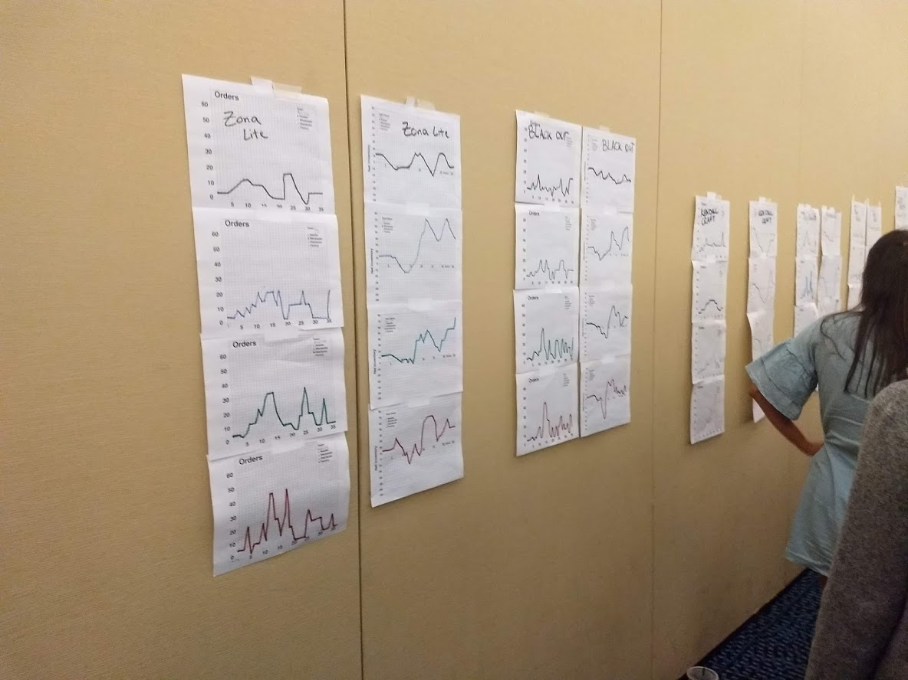
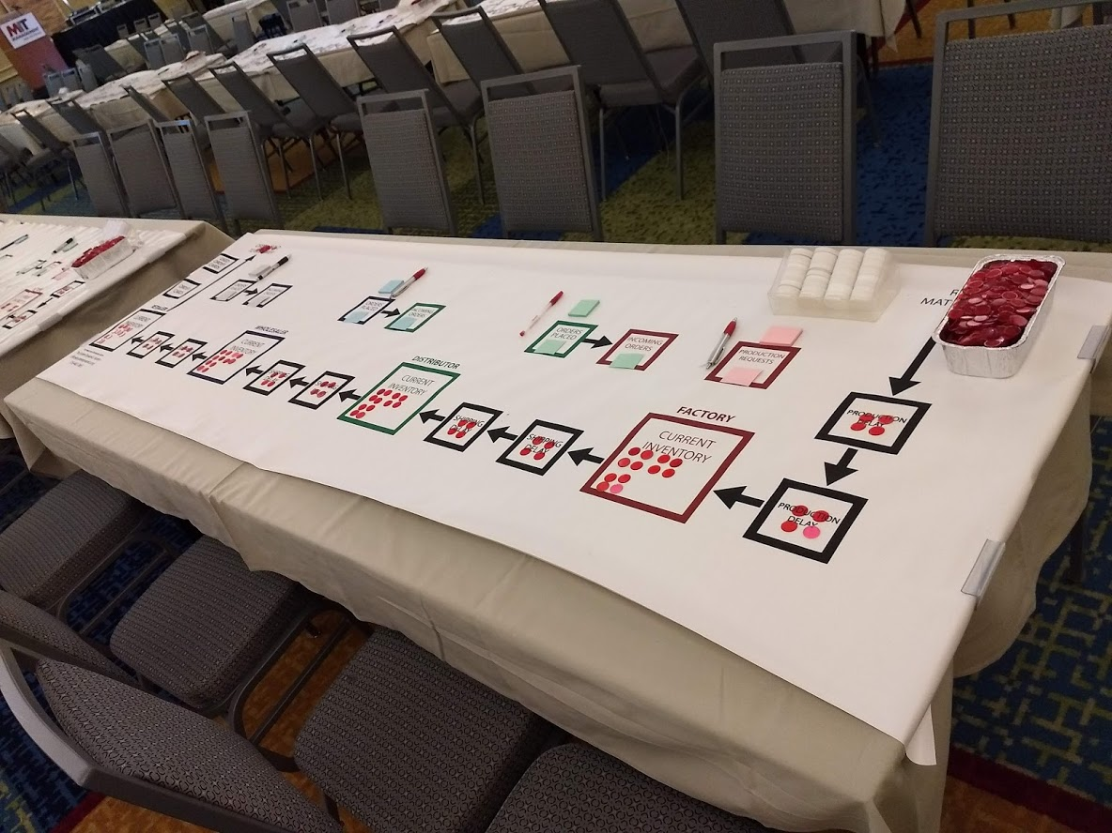
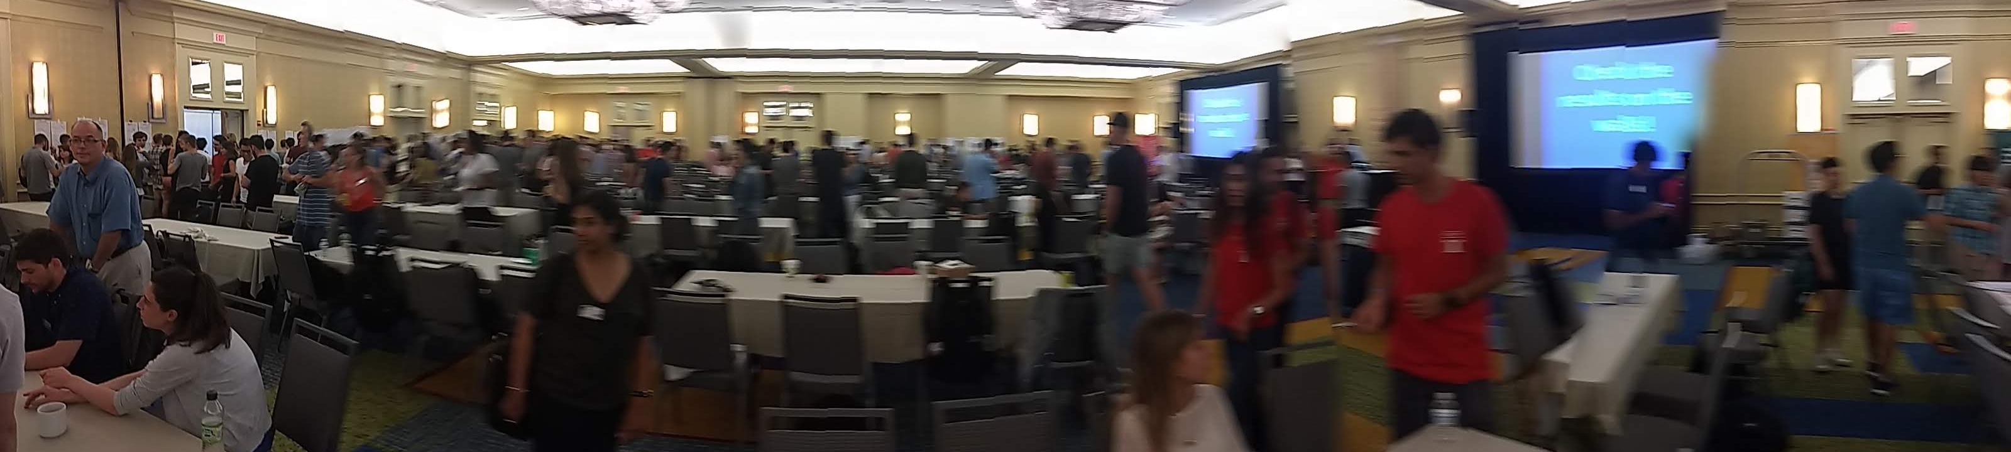
Modeling Framework: THE BEER GAME

Slide 7
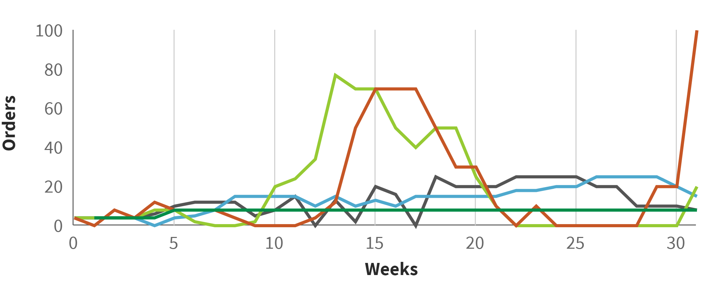
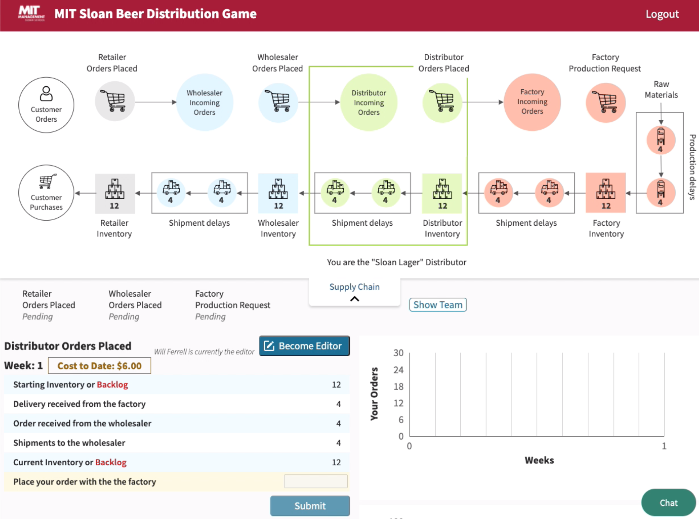
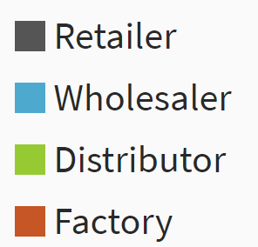
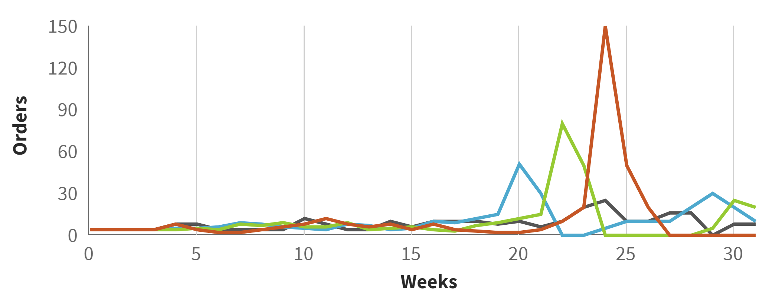
Modeling Framework: THE BEER GAME
‘Team8’ - Online Beer Game – August 13, 2021
‘Team10’ - Online Beer Game – August 27, 2021

Slide 8
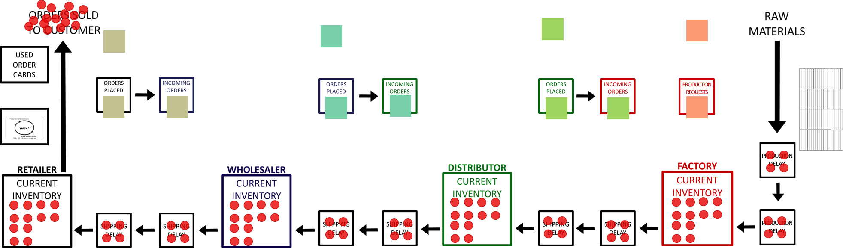

Modeling Framework: THE BEER GAME

Slide 9
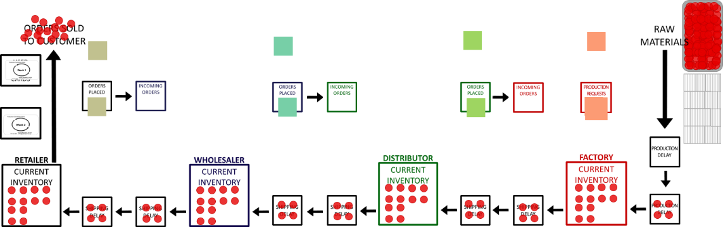
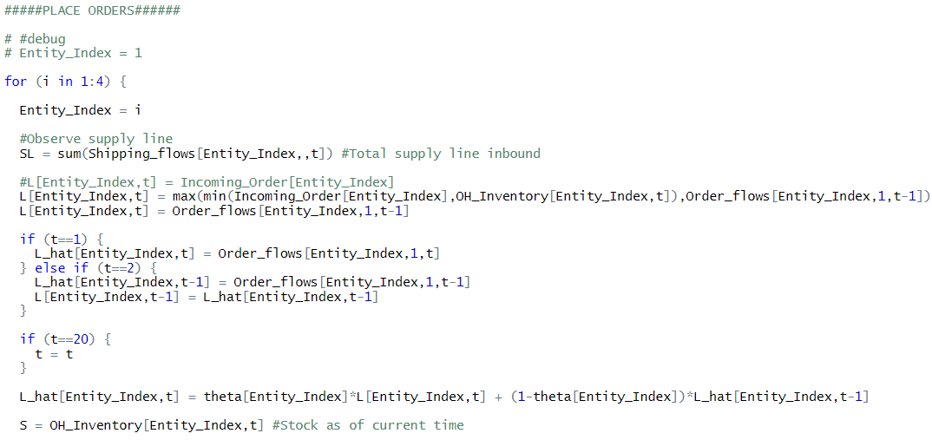
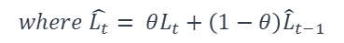
Behavioral Ordering Model
Self-Contained Simulation Model of the Beer Game
Discrete time simulation
Based on classic Sterman ‘89 configuration
Ordering rule based on four parameters:
$$O_{t}=MAX\left(0,\hat{L_{t}}+α_{S}\left(S^{′}−S_{t}−β SL_{t}\right)+ε_{t}\right)$$
$$where \hat{L_{t}}= θL_{t}+\left(1−θ\right){\hat{L}}_{t−1}$$
O = order placed at time t
L ̂ = smoothed interpolation of the expected outflow of inventory
Θ = smoothing parameter
SL = total inbound supply line of inventory
S = current on-hand inventory (or stock)
S’ = analogous to the desired or goal on-hand inventory of the player
β = weight of supply line

Slide 10

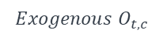
Behavioral Ordering Model
$$O_{t,1}$$
$$Exogenous O_{t,c}$$
$$O_{t,1}=MAX\left[0, f\left(θ_{1}\right)+α_{1}\left(S_{1}^{′}−S_{t,1}−β_{1} SL_{t,1}\right)\right]$$
$$O_{t,2}=MAX\left[0,f\left(θ_{2}\right)+α_{2}\left(S_{2}^{′}−S_{t,2}−β_{3} SL_{t,2}\right)\right]$$
$$O_{t,3 }=MAX\left[0,f\left(θ_{3}\right)+α_{3}\left(S_{3}^{′}−S_{t,3}−β _3 SL_{t,3}\right)\right]$$
$$O_{t,4 }=MAX\left[0,f\left(θ_{4}\right)+α_{4}\left(S_{4}^{′}−S_{t,4}−β_{4} SL_{t,4}\right)\right]$$

Slide 11
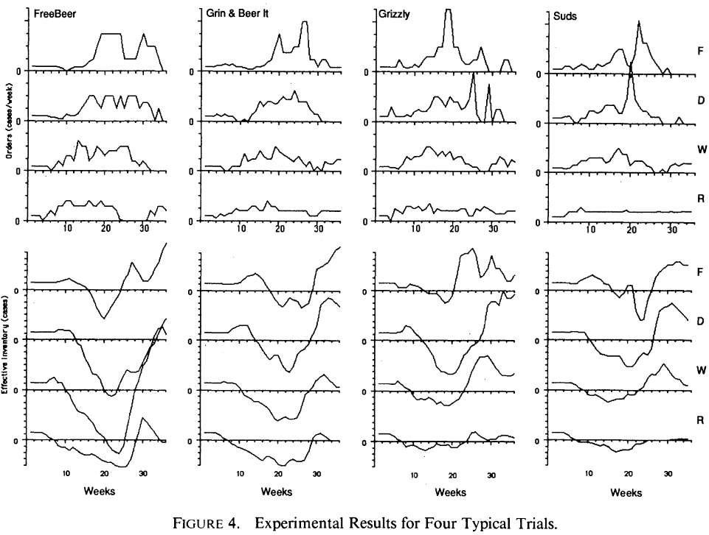
Methods: Simulation Setup
Test of baseline model of human ordering
from Sterman (1989) https://doi.org/10.1287/mnsc.35.3.321

Slide 12
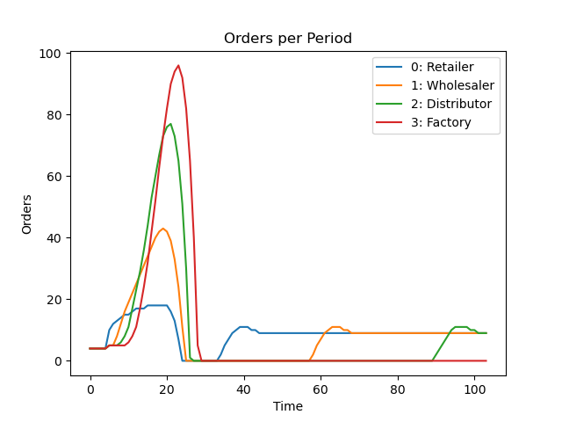
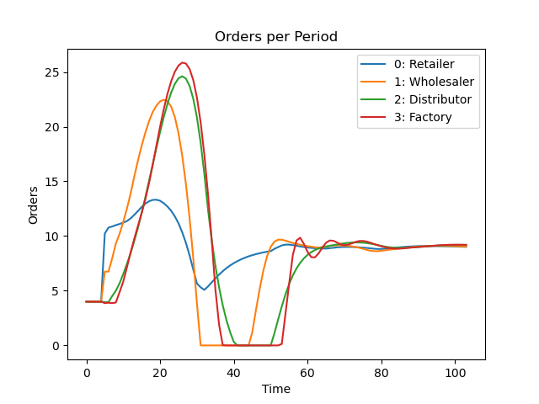
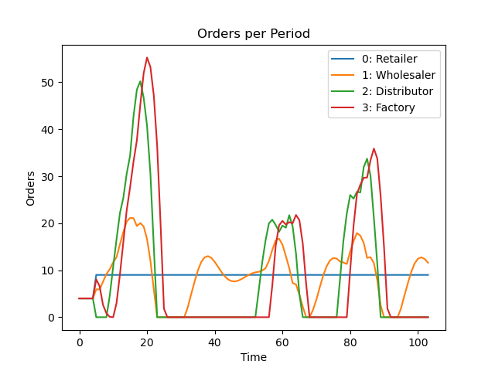
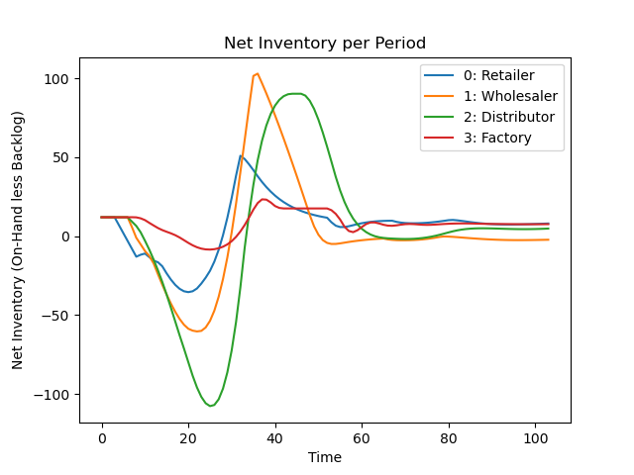
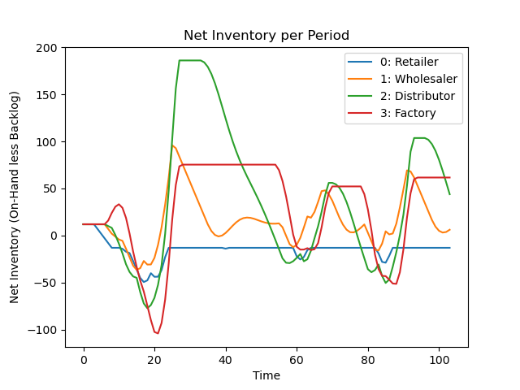
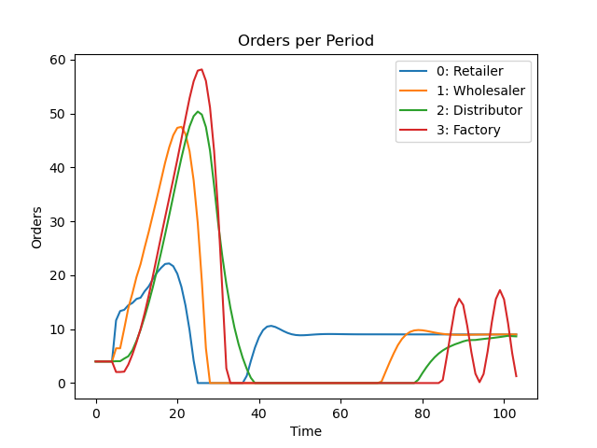
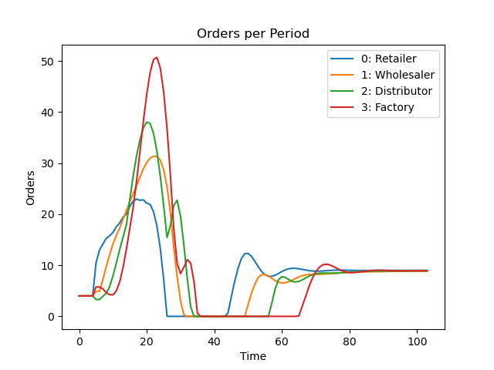
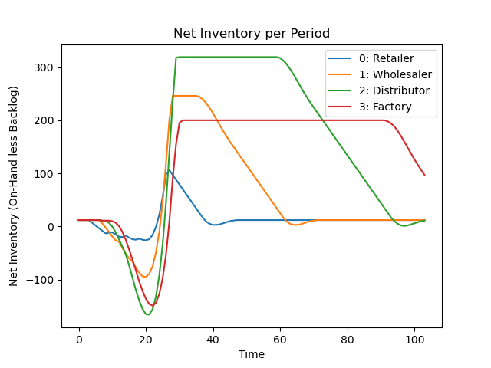
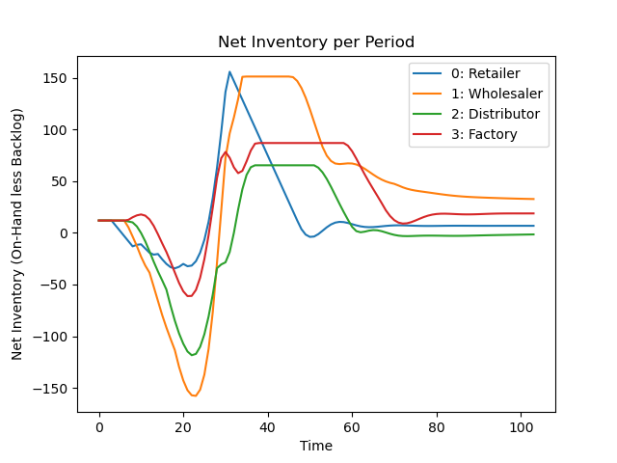
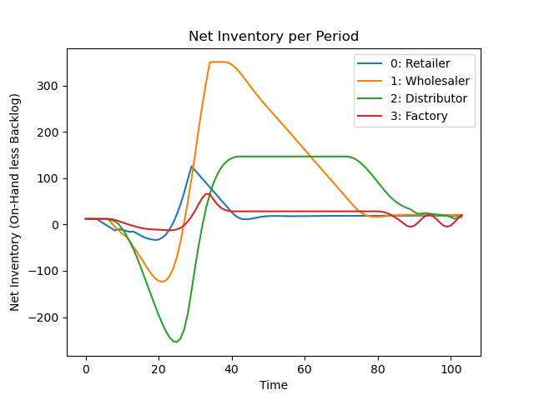
Simulation of Human Ordering
Test of baseline model of human ordering
Sterman ‘89 #1
Sterman ‘89 #10
Avg Aggregate Team
Sterman ‘89 #4
Sterman ‘89 #6
Simulation can reproduce typical bullwhip phenomena

Slide 13
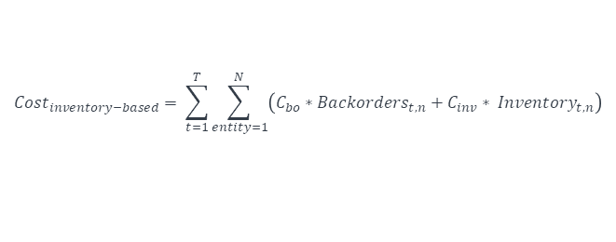
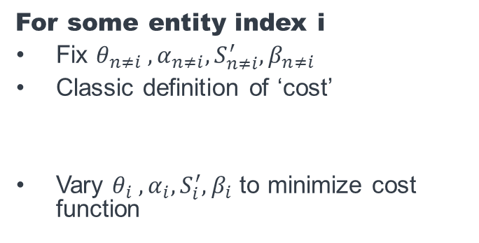
Model-Based Optimization
For some entity index i
Fix $θ_{n≠i} ,α_{n≠i},S_{n≠i}^{′},β_{n≠i}$
Classic definition of ‘cost’
Vary $θ_{i} ,α_{i},S_{i}^{′},β_{i}$ to minimize cost function
$$O_{t,1}$$
$$Cost_{inventory−based}= \sum_{t=1}^{T}{\sum_{entity=1}^{N}{\left(C_{bo}∗Backorders_{t,n}+C_{inv}∗ Inventory_{t,n}\right)}}$$
$$Exogenous O_{t,c}$$
$$O_{t,1}=MAX\left[0, f\left(θ_{1}\right)+α_{1}\left(S_{1}^{′}−S_{t,1}−β_{1} SL_{t,1}\right)\right]$$
$$O_{t,2}=MAX\left[0,f\left(θ_{2}\right)+α_{2}\left(S_{2}^{′}−S_{t,2}−β_{3} SL_{t,2}\right)\right]$$
$$O_{t,3 }=MAX\left[0,f\left(θ_{3}\right)+α_{3}\left(S_{3}^{′}−S_{t,3}−β _3 SL_{t,3}\right)\right]$$
$$O_{t,4 }=MAX\left[0,f\left(θ_{4}\right)+α_{4}\left(S_{4}^{′}−S_{t,4}−β_{4} SL_{t,4}\right)\right]$$
Notes:
C_bo = $1.00 and C_inv = 0.50 per classic beer game
“ψ and γ were chosen as +25 and +1 respectively, simply for convenience of scaling the typical output of this function to the same order of magnitude as that generated by expression (3). “

Slide 14
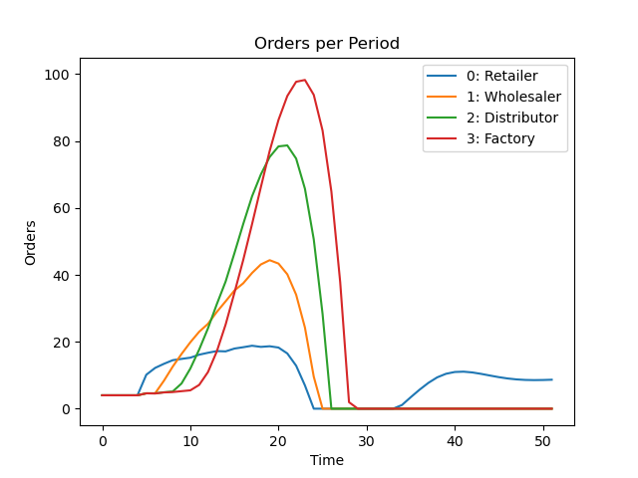
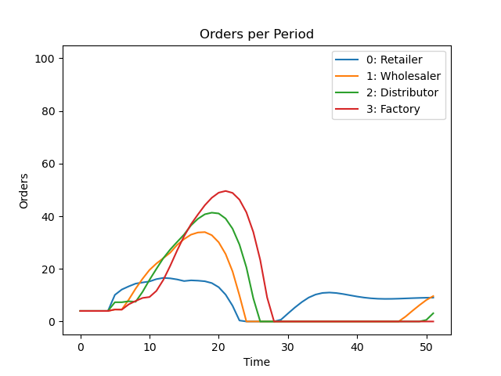
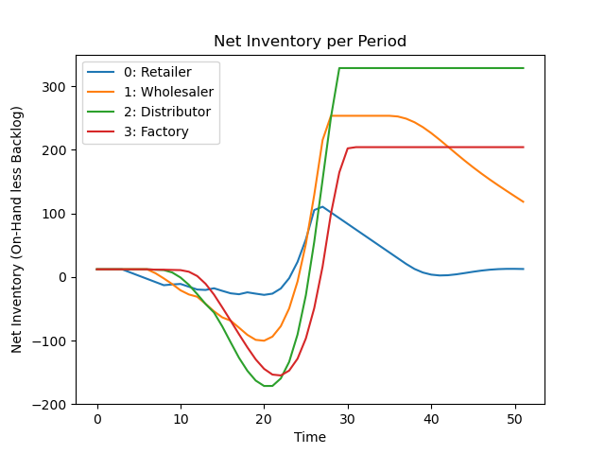
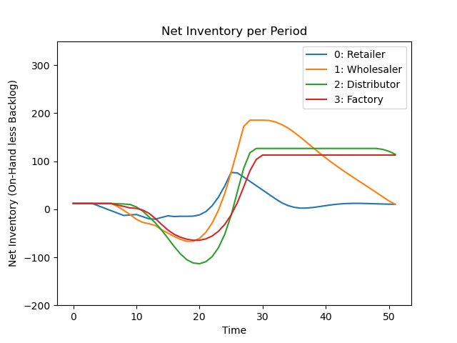
Illustrative Model-Based Result against Step Change in Customer Orders
Opt Agent at ‘Distributor’ Position
For 52 simulated weeks: Baseline Costs = 13,394
Costs with Optimized Entity = 7,406 (-48%)

Slide 15

Model-Based Observations
$$O_{t}=MAX\left(0,\hat{L_{t}}+α_{S}\left(S^{′}−S_{t}−β SL_{t}\right)+ε_{t}\right)$$
$$where \hat{L_{t}}= θL_{t}+\left(1−θ\right){\hat{L}}_{t−1}$$
Shared Features of the Optimized Agents
Low values of θ for the Retailer and high values of θ for everyone else
Determines the degree of smoothing in updating each entity’s expectation of future orders (Anchoring and Adjustment)
Low values of θ = slow to update expectations, while high values of θ = is quick to adopt the new order signal
Retailer dubious about customer orders, all other entities quick to update
Analogous to degree of trust in order signal from downstream partner, matches prior research
Very high values of β (at or near 1.0) at all positions in the supply chain
Directly corresponds to Supply Chain Underweighting
Entities do not forget their orders and nearly completely consider inbound supply
Matches existing best practices from literature and counteracts largest hypothesized source of Bullwhip
Values of S’ resembling a base-sock replenishment method
Classic solution to Bullwhip with perfect customer distribution knowledge is base stock replenishment
S’ at or near 36 in all optimizations (and higher in less stable positions), which matches base stock level under uniform random centered around 8 units with total inventory delay of 4 units of time
Notes:
(Özer et al., 2011).

Slide 16
Are these Observations Generalizable?
Does this Model-Based approach improve performance (mitigate bullwhip) just for this scenario?
$$O_{t,1}$$
Or is it more generally applicable?
…and was a model-based approached necessary to begin with?
Notes:
(Özer et al., 2011).

Slide 17
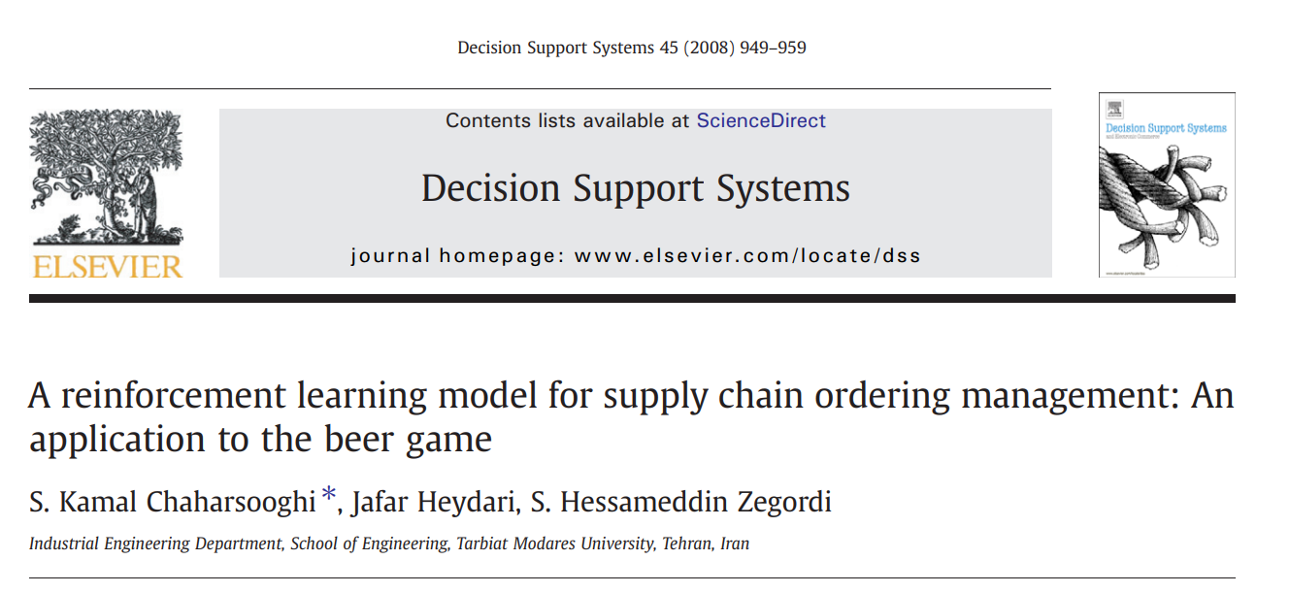
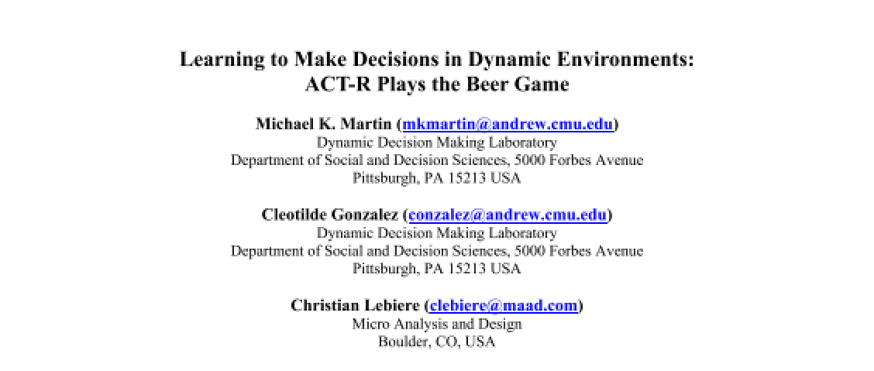
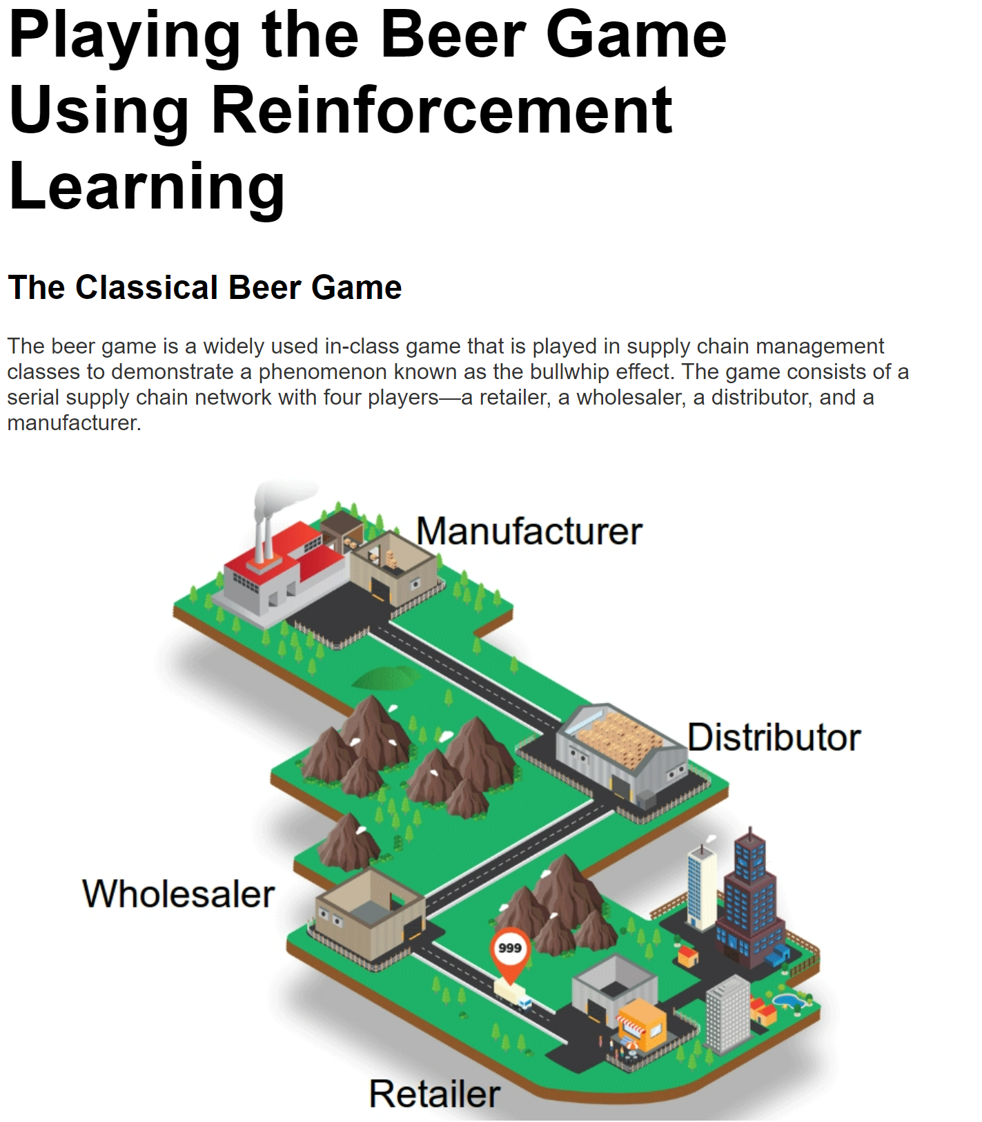
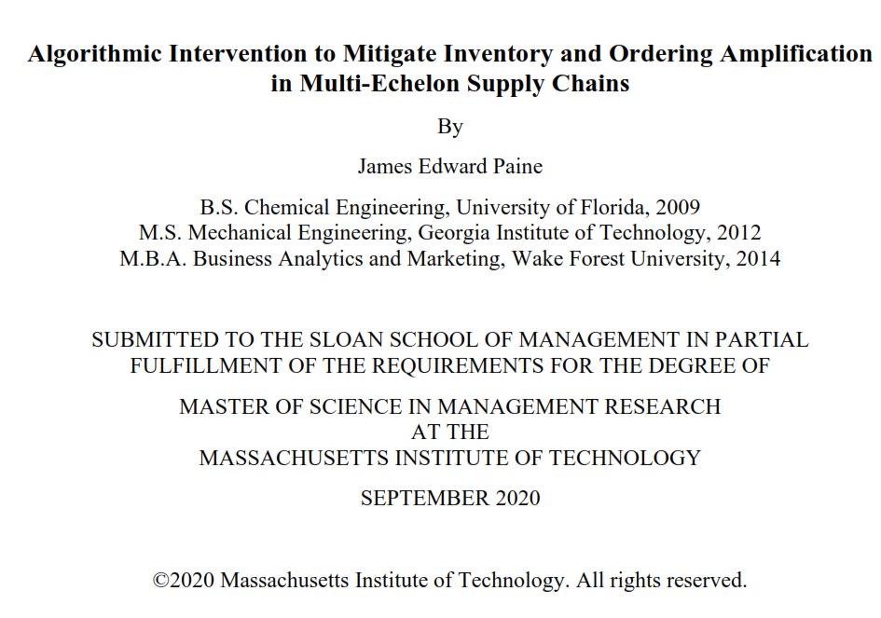
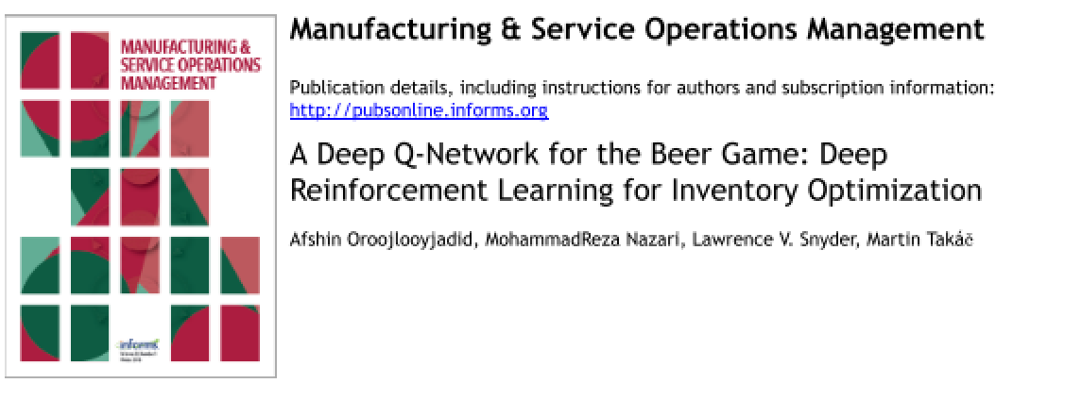

Model Free vs Model Based Policy Optimization
Model Based Approaches
Model Free Approaches
e.g. Chaharsooghi et.al. 2008
e.g. Martin et.al. 2004
Oroojlooyjadid et.al. 2021
Opex Analytics 2018
Paine 2020
Deep Q Network Agent as been shown to be applicable here (Oroojlooyjadid et.al. 2021)
Prior RL work shows RL is possible in this space but does not a
Gym Environment as flexible framework to use functional form of beer game as environment to train model-free agent
Notes:
Dueling Network Architectures for Deep Reinforcement Learning
A Deep Q-Network for the Beer Game: Deep Reinforcement Learning for Inventory Optimization -

Slide 18
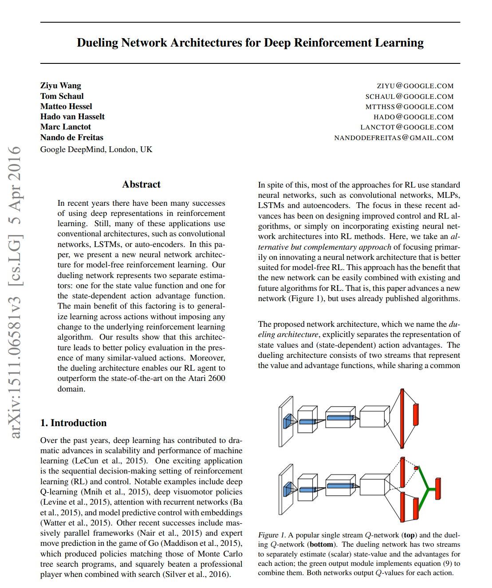
Extending Existing Model Free Approaches
Existing Model Free Approaches
Deep Q Network Agent as been shown to be applicable here with modifications(Oroojlooyjadid et.al. 2021)
Introduced transfer learning to increase training speed and modified DQN algorithm to allow for independent training with pools supply chain rewards
(Some) Key Difficulties
True ‘full state’ information is unknown to any one entity
Rewards are communal and not known until the end
Current state matters almost as much as, if not more than, any specific action
Wang 2016 (pre-print)
Possible Solutions
Break out state and action Q networks
Maintain sequential memory of prior actions
Use ‘order-plus’ action space
Notes:
Dueling Network Architectures for Deep Reinforcement Learning
A Deep Q-Network for the Beer Game: Deep Reinforcement Learning for Inventory Optimization -

Slide 19
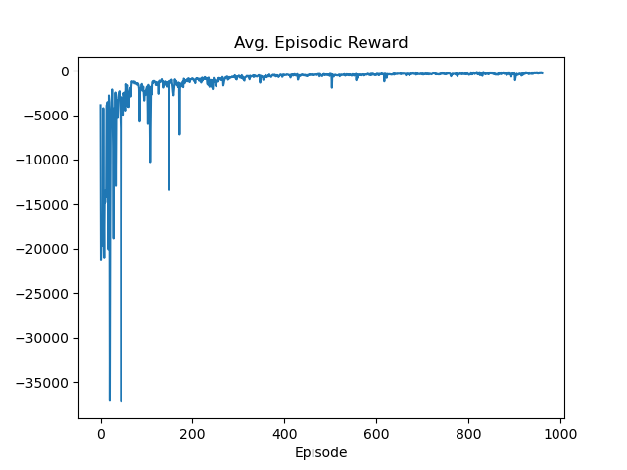
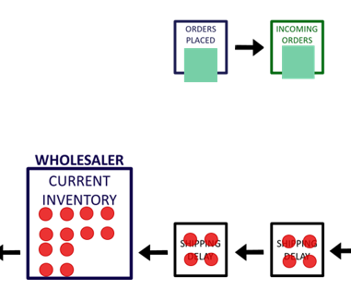
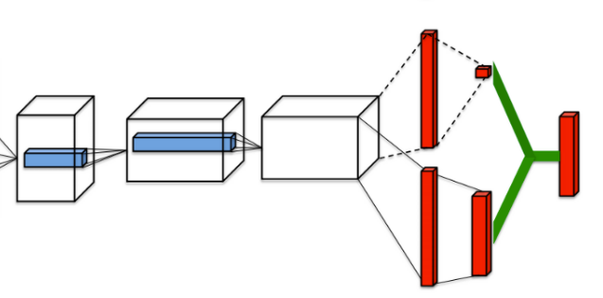
DQN Structure
Framework
OpenAI Gym custom environment based on same functional-form of Beer Game developed in Model-based optimization
Environment consisting of:
All supply chain positions in parallel (versus transfer learning in sequence)
Randomly drawn models of real teams (from Sterman ’89)
Random but bounded simulation horizons
Noisy realizations of order decisions
DQN Architecture
Dual DQN network (split Action / State Q values)
Three sequential dense layers with ReLu activation
Order-plus action space guided by prior model-optimization
Combination of epsilon-greedy and Boltzmann policy (Wiering 1999)
Observation space limited to data available in Beer Game (x4 window for sequential memory)
State Value V(s)
Q(s,a)
(Wang 2015)
Advantage Value a(s,a)
Notes:
Dueling Network Architectures for Deep Reinforcement Learning
A Deep Q-Network for the Beer Game: Deep Reinforcement Learning for Inventory Optimization -

Slide 20
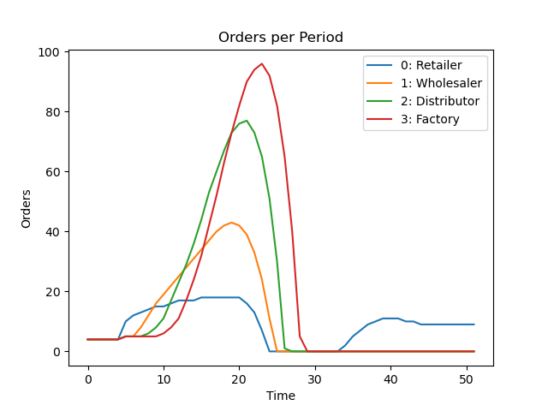
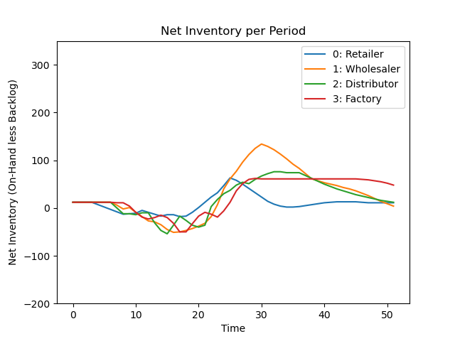
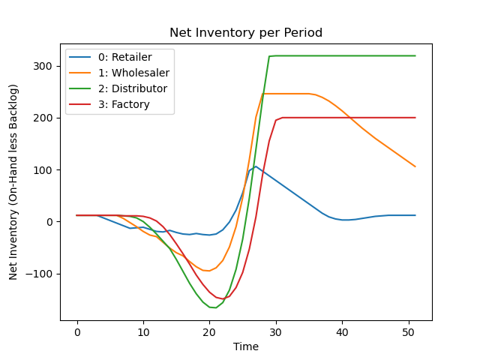

Illustrative Model-Free Result against Step Change in Customer Orders
✔️
DQN at ‘Wholesaler’ Position
Dual DQN appears effective at reducing costs in Simulated Beer game
For 52 simulated weeks:
Baseline Costs = 13,394 Costs with DQN = 4,145 (-69%)

Slide 21

Model Free vs Model Based Policy Optimization
Probe Boundary between Approaches
Apply both approaches to scenarios outside of training environment
Randomly drawn teams based on ‘real’ human players
Increasingly noisy realization of ordering decisions by other players
Compare across all positions in the supply chain
Model Based Approaches
Model Free Approaches
Details
For each instance:
Randomly draw from ordering models for 11 ‘real’ team members
Adjust ordering decision for other players by $O_{t,i}={\hat{O}}_{t,i}+N(0,σ^{2})$
Perform 100 reptations both with and without (as baseline average) agent in play
Repeat for each entity position and varying $σ$
Notes:
Dueling Network Architectures for Deep Reinforcement Learning
A Deep Q-Network for the Beer Game: Deep Reinforcement Learning for Inventory Optimization -

Slide 22

Model Free vs Model Based Policy Optimization
Model-Based Approach
Model-Free Approach
 | Supply Chain Position
 | Retailer | Wholesaler | Distributor | Factory
0.0 | -57% | -25% | -59% | -38%
0.5 | -54% | -31% | -60% | -40%
1.0 | -52% | -30% | -59% | -39%
1.5 | -52% | -27% | -57% | -34%
2.0 | -49% | -26% | -57% | -33%
2.5 | -41% | -22% | -57% | -32%
3.0 | -39% | -22% | -55% | -34%
3.5 | -42% | -22% | -55% | -31%
4.0 | -32% | -20% | -49% | -29%
4.5 | -27% | -11% | -47% | -27%
5.0 | -34% | -13% | -48% | -27%
5.5 | -31% | -11% | -47% | -25%
6.0 | -25% | -6% | -42% | -23%
6.5 | -29% | -4% | -41% | -26%
7.0 | -32% | -2% | -35% | -19%
7.5 | -28% | 2% | -39% | -17%
8.0 | -23% | 3% | -36% | -17%
8.5 | -21% | 1% | -39% | -18%
9.0 | -25% | 11% | -29% | -14%
9.5 | -26% | 1% | -30% | -14%
10.0 | -28% | 21% | -32% | -15%
10.5 | -28% | 21% | -34% | -14%
11.0 | -25% | 16% | -34% | -11%
11.5 | -25% | 21% | -28% | -7%
12.0 | -30% | 17% | -26% | -8%
12.5 | -23% | 23% | -29% | -23%
13.0 | -32% | 14% | -25% | -16%
13.5 | -21% | 27% | -16% | 2%
14.0 | -24% | 16% | -23% | -10%
14.5 | -30% | 35% | -27% | -11%
15.0 | -26% | 30% | -16% | -22%
 | Supply Chain Position
 | Retailer | Wholesaler | Distributor | Factory
0.0 | -36% | -44% | -38% | 26%
0.5 | -35% | -46% | -38% | 27%
1.0 | -25% | -50% | -43% | 31%
1.5 | -38% | -58% | -47% | 22%
2.0 | -27% | -54% | -43% | 17%
2.5 | -24% | -55% | -48% | 19%
3.0 | -29% | -60% | -43% | 28%
3.5 | -28% | -59% | -44% | 19%
4.0 | -18% | -56% | -50% | 21%
4.5 | -23% | -55% | -50% | 0%
5.0 | -27% | -57% | -48% | 21%
5.5 | -15% | -58% | -50% | -7%
6.0 | -25% | -52% | -45% | 4%
6.5 | -19% | -48% | -41% | 6%
7.0 | -25% | -46% | -44% | -3%
7.5 | -28% | -48% | -44% | 0%
8.0 | -19% | -46% | -42% | -3%
8.5 | -14% | -39% | -41% | 8%
9.0 | -16% | -36% | -27% | 14%
9.5 | -7% | -40% | -32% | -4%
10.0 | -13% | -30% | -44% | 7%
10.5 | -15% | -27% | -39% | -2%
11.0 | -16% | -33% | -37% | 4%
11.5 | -9% | -30% | -31% | 3%
12.0 | -19% | -22% | -34% | 3%
12.5 | -13% | -19% | -35% | -17%
13.0 | -16% | -26% | -32% | -11%
13.5 | -9% | -20% | -24% | 10%
14.0 | -14% | -24% | -31% | -5%
14.5 | -12% | -17% | -32% | -5%
15.0 | -8% | -19% | -26% | -18%
Average Cost Reduction over 100 runs versus 100 similar baseline runs:
$σ$as used in $O_{t,i}={\hat{O}}_{t,i}+N(0,σ^{2})$
Notes:
Dueling Network Architectures for Deep Reinforcement Learning
A Deep Q-Network for the Beer Game: Deep Reinforcement Learning for Inventory Optimization -

Slide 23

Model Free vs Model Based Policy Optimization
Pts Difference Model-Free vs Model-Based Approach
Which Approach ‘Did Better’?
 | Supply Chain Position
 | Retailer | Wholesaler | Distributor | Factory
0.0 | Model | DQN | Model | Model
0.5 | Model | DQN | Model | Model
1.0 | Model | DQN | Model | Model
1.5 | Model | DQN | Model | Model
2.0 | Model | DQN | Model | Model
2.5 | Model | DQN | Model | Model
3.0 | Model | DQN | Model | Model
3.5 | Model | DQN | Model | Model
4.0 | Model | DQN | DQN | Model
4.5 | Model | DQN | DQN | Model
5.0 | Model | DQN | DQN | Model
5.5 | Model | DQN | DQN | Model
6.0 | DQN | DQN | DQN | Model
6.5 | Model | DQN | DQN | Model
7.0 | Model | DQN | DQN | Model
7.5 | Model | DQN | DQN | Model
8.0 | Model | DQN | DQN | Model
8.5 | Model | DQN | DQN | Model
9.0 | Model | DQN | Model | Model
9.5 | Model | DQN | DQN | Model
10.0 | Model | DQN | DQN | Model
10.5 | Model | DQN | DQN | Model
11.0 | Model | DQN | DQN | Model
11.5 | Model | DQN | DQN | Model
12.0 | Model | DQN | DQN | Model
12.5 | Model | DQN | DQN | Model
13.0 | Model | DQN | DQN | Model
13.5 | Model | DQN | DQN | Model
14.0 | Model | DQN | DQN | Model
14.5 | Model | DQN | DQN | Model
15.0 | Model | DQN | DQN | Model
 | Supply Chain Position
 | Retailer | Wholesaler | Distributor | Factory
0.0 | -20.5 | 19.0 | -21.6 | -63.7
0.5 | -19.0 | 15.0 | -21.7 | -66.8
1.0 | -26.4 | 20.2 | -16.6 | -69.8
1.5 | -13.8 | 30.7 | -10.6 | -55.8
2.0 | -21.9 | 28.0 | -13.6 | -49.5
2.5 | -17.8 | 32.8 | -9.0 | -50.6
3.0 | -10.1 | 37.5 | -12.1 | -62.1
3.5 | -13.9 | 37.5 | -10.7 | -50.7
4.0 | -14.5 | 35.6 | 0.9 | -49.7
4.5 | -4.1 | 44.7 | 3.3 | -26.9
5.0 | -6.7 | 43.2 | 0.4 | -48.7
5.5 | -15.5 | 47.3 | 3.5 | -17.9
6.0 | 0.1 | 46.4 | 2.2 | -27.1
6.5 | -9.6 | 44.4 | 0.4 | -32.1
7.0 | -7.1 | 44.4 | 8.7 | -15.8
7.5 | -0.3 | 50.5 | 5.5 | -17.0
8.0 | -3.7 | 49.2 | 6.5 | -14.1
8.5 | -7.0 | 40.9 | 2.0 | -26.1
9.0 | -8.9 | 46.8 | -2.2 | -27.8
9.5 | -18.6 | 41.5 | 2.0 | -10.0
10.0 | -15.4 | 51.7 | 11.7 | -21.8
10.5 | -13.2 | 47.7 | 5.2 | -11.8
11.0 | -9.6 | 49.5 | 2.6 | -14.7
11.5 | -16.9 | 51.7 | 2.7 | -9.7
12.0 | -10.3 | 39.6 | 7.2 | -11.3
12.5 | -10.0 | 41.6 | 5.9 | -6.6
13.0 | -16.5 | 39.5 | 6.3 | -4.9
13.5 | -11.7 | 47.6 | 7.7 | -8.5
14.0 | -10.8 | 40.2 | 7.4 | -5.0
14.5 | -18.1 | 52.3 | 4.5 | -5.8
15.0 | -17.9 | 49.0 | 9.9 | -4.4
$σ$as used in $O_{t,i}={\hat{O}}_{t,i}+N(0,σ^{2})$
Notes:
Dueling Network Architectures for Deep Reinforcement Learning
A Deep Q-Network for the Beer Game: Deep Reinforcement Learning for Inventory Optimization -

Slide 24





Model Free vs Model Based Policy Optimization
$${π_{i}}_{DQN−MB}=β_{i}\left(σ\right)+C_{i}$$
Entity i | 𝛽_{𝑖} | T-Stat (dof = 30)
0: Retailer | 0.240 | 0.96
1: Wholesaler | 1.545** | 5.55
2: Distributor | 1.680** | 7.84
4: Factory | 4.343** | 12.69
Average Cost Contribution by Position for recent (Aug 2021) real world beer games:
Retailer 14%
Wholesaler 22%
Distributor 33%
Factory 32%
*Average over 31 teams
Notes:
Dueling Network Architectures for Deep Reinforcement Learning
A Deep Q-Network for the Beer Game: Deep Reinforcement Learning for Inventory Optimization -

Slide 25
Discussion
Model-Based and Model-Free Approaches Complement Each Other
Model-free DQN approach becomes more valuable under more noisy environments
Is generally more valuable in more ‘decoupled’ positions (Wholesaler and Distributor)
These positions contribute ≈55% of total costs in recent real-world games
Behavioral Model-Based Approach is surprisingly robust
Unless applied highly noisy environment, still generally cost reducing
Lends validity to observations about damped ordering behavior drawn in first part of research and prior behavioral work
Avoid supply chain underweighting and trust your supply chain neighbors
Directly interpretable in the context of existing behavior research and thus possibly more generalizable to other environments
Model Based Approaches
Model Free Approaches
Notes:
Dueling Network Architectures for Deep Reinforcement Learning
A Deep Q-Network for the Beer Game: Deep Reinforcement Learning for Inventory Optimization -

Slide 26
Further Discussion
Let People be People
Generally, introduction of optimized agent, either model-free or model-based, reduces bullwhip
Does so without imposing any additional constraints on the behavioral ordering of the human partners in the system
Limitations
This is an empirically grounded simulation, but not an empirically verified one (yet)
Important concerns in real supply chains (integration, cost sharing, etc) are ignored here. The definition of ‘cost’ matters!
Training data is from a stationary demand signal, which is ‘memorized’ in the model-based optimization
Model-free approach may not be as affected by this limitation

Slide 27
Conclusion and Future Work
Created and compared Model-Based and Model-Free algorithmic intervention to mitigate Bullwhip
Model-Based Intervention interpretable in the context of existing hypothesized best practices in supply chain management
Model-Free Intervention utilizes Dual DQN structure in novel setting and reduces costs at main sources of supply chain and under increasingly noisy environments
Neither relies on changing behavioral features of people making ordering decisions
Model
DQN
Next Steps: Empirical Test and Extension
Two additional questions to answer:
Does the presence of an algorithmic intervention mitigate bullwhip outside of this model?
Does knowledge of the presence of such a machine modify human ordering behavior?
Notes:
(Özer et al., 2011).

Slide 28

Thank You!
Please send questions and comment to:
James Paine
jpaine@mit.edu
jpaine.mit.edu
github.mit.edu/jpaine/Taming-the-Bull

Slide 29
Supporting Documents
Results Table: General Optimizations
Results Table: Turning Parameters On and Off
Paper Write-Up of these Results
Software Design Document for Empirical Test

Slide 30
Additional Details on Empirical Extension Setup
James Paine
jpaine@mit.edu
jpaine.mit.edu

Slide 31


Set up for Empirical Study
Created Software Design Document
IEE-1016 compliant (I hope!)
Based on Empirica as multiplayer platform
Lays out specific purpose, scope, and design requirements of proposed experiment
Specifically leaves room to do additional tests in the future
Existing research is interesting, but empirical testing is still needed!

Slide 32
Proposed Additional Study
Does the Presence of a Machine Change Ordering Decisions?
Create and train algorithmic player in the Beer Game, based on features seen in high CRT players
Preliminary tests suggest Wholesaler as high leverage point for testing
Treatments to test both influence of algorithmic intervention in general and if knowledge of presence of the algorithm changes ordering behavior
Notes:
Look into archetypes in supply chain at this point
What about control condition?

Slide 33
Proposed Additional Study
Stage 2 Full Design
Existing Research
Actual Player
Human
Machine
Well defined and researched
(Sterman, Donohue, Corson, etc.)
High bullwhip and high costs
Research on Computer/Human interaction gives differing outcomes
Higher relationship building, but may increase costs
Human
Perceived Player
Research on Computer/Human interaction gives differing outcomes
Unresearched space
Limited research
Oroojlooyjadid et al and this paper imply performance boost.
Reeve and Nass imply no behavior shift but Shechtman and Horowitz do.
Machine
Notes:
Look into archetypes in supply chain at this point
What about control condition?

Slide 34
Included Mechanisms and Variables
Variable | Manipulated? | Value | Units | Notes
Entity_Index | TRUE | 1,2,3,4 (likely limited to 2 and or 3) |  | Study 1 and 2
AI_Entity | TRUE | TRUE |  | Study 1
AI_Entity | TRUE | TRUE / FALSE |  | Study 2
Reveal_AI | TRUE | TRUE / FALSE |  | Study 2
θ (Non AI Entities) | Indirectly | Imputed from human players | dml
β (Non AI Entities) | Indirectly | Imputed from human players | dml
S’ (Non AI Entities) | Indirectly | Imputed from human players | units
α (Non AI Entities) | Indirectly | Imputed from human players | dml
Notes:
TIME AND QUESTIONS ALLOWING

Slide 35
Excluded Mechanisms and Variables
Variable | Manipulated? | Value | Units
Random Team | FALSE | FALSE
Random Entities | FALSE | FALSE
θ (AI Entity) | FALSE | Optimization Dependent | dml
β (AI Entity) | FALSE | Optimization Dependent | dml
S’ (AI Entity) | FALSE | Optimization Dependent | units
α (AI Entity) | FALSE | Optimization Dependent | dml
Order_type | FALSE | Classic
Step_Round | FALSE | 5 | period
Starting_Cust_Order | FALSE | 4 | units
Step_Value | FALSE | 8 | units
Integer Ordering | FALSE | TRUE
Time Horizon | FALSE | 36 | periods
Initial_Inventory | FALSE | 12 | units
Holding_Cost | FALSE | 0.5 | $
Backorder_Cost | FALSE | 1 | $
Shipping_Delay | FALSE | 2 | periods
Information_Delay | FALSE | 2 | periods
Max_Profit_Min_Cost | FALSE | Min_Cost
Notes:
TIME AND QUESTIONS ALLOWING

Slide 36
Key Dependent Variables
Key Supply Chain Indicators
Net inventory
Orders
Measurement of bullwhip
Amplitude? Sign test? SD? Many options here
Cost (both per period and cumulative)
Behavioral Indicators
Supply Line Underweighting β
Others:
Cognitive Reflection
θ as proxy of trust
Coordination Risk

Slide 37
Time Horizon
Key Supply Chain Indicators
Over simulation horizon
Net inventory
Orders
Measurement of bullwhip
Cost (both per period and cumulative)
Point totals (after simulation)
Behavioral Indicators
Supply Line Underweighting β
Others:
Cognitive Reflection
θ as proxy of trust
Coordination Risk
Point Estimates
(With and Without treatments)
Notes:
Add assigning blame?

Slide 38


Reference Modes

Slide 39



Status and Next Steps
…for this semester:
Study 1
Create optimizable functional form of the Beer Game
Self-contained simulation of the system over a given time horizon
Callable function that takes a given state-action pair and returns an updated state
Create dynamic environment to train a model based on actual performance and feedback in the Beer Game
Qualitatively examine the ‘optimized’ ordering choices
How do choices vary based on position in the supply chain?
How do these choices map to existing models of human behavior in multi-echelon supply chains?
Empirically Test
Real-world tests of optimization techniques missing from existing literature
Opportunity to see how applicable different classes of optimization are
Study 2
Extend and Test for Human-Machine Interactions
Design version of empirical test that varies if the players know that the algorithmic intervention is present or not
Specifically if it is a ‘human’ or ‘machine’ player
Scale up Study 1 and Study 2 to increase study power
Extend beyond demonstration mode
Allow more robust testing of DNN and other similar methods
Notes:
END OF MAIN PRESENTATION

